Slide 1
Famous Fathers
Session Four - Share the Good News - Son of Man

Slide 2
1.

Slide 3
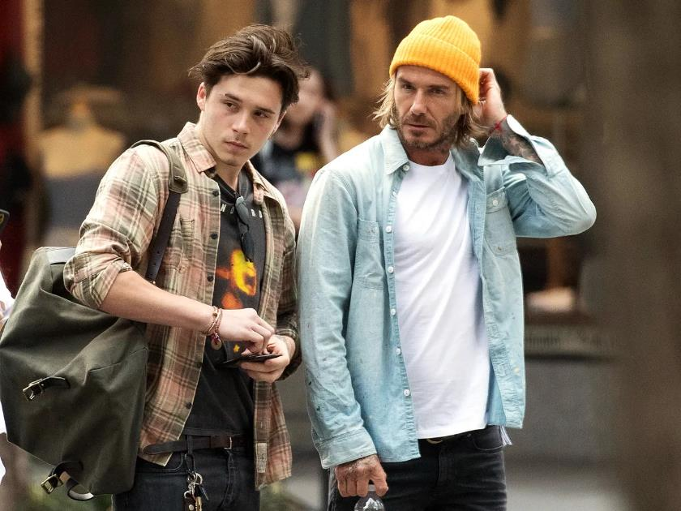
1.
Child: Brooklyn Beckham
Father: David Beckham

Slide 4
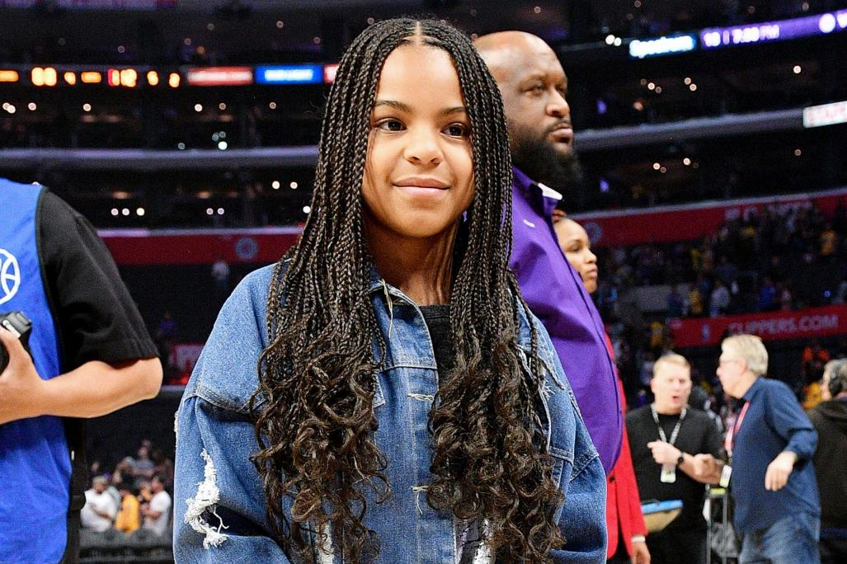
2.

Slide 5
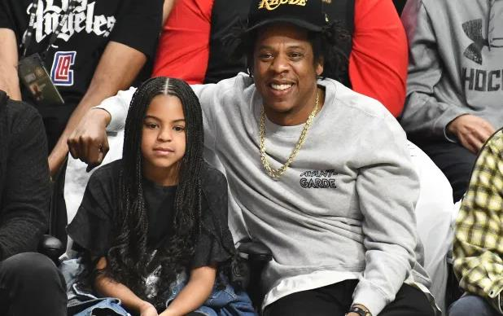
2.
Child: Blue Ivy
Father: Jay-Z

Slide 6
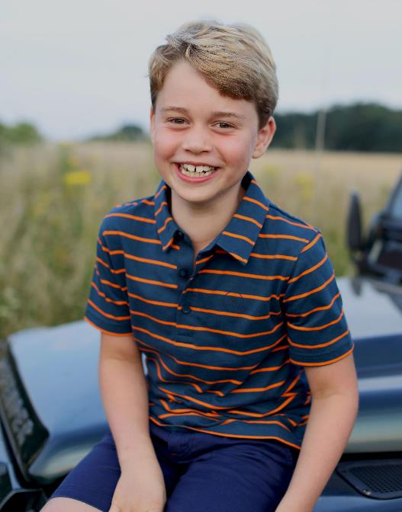
3.

Slide 7
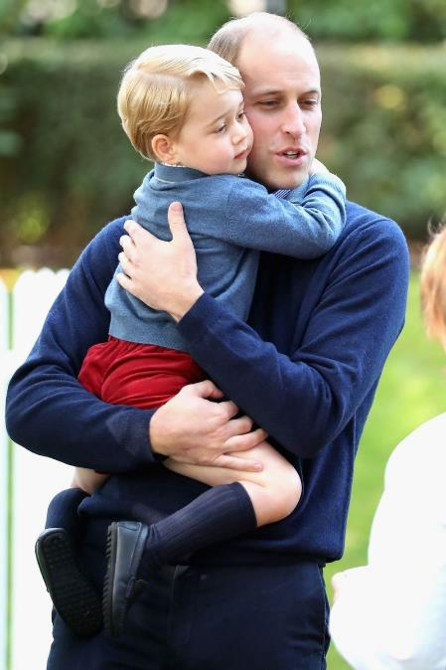
3.
Child: Prince George
Father: Prince William

Slide 8
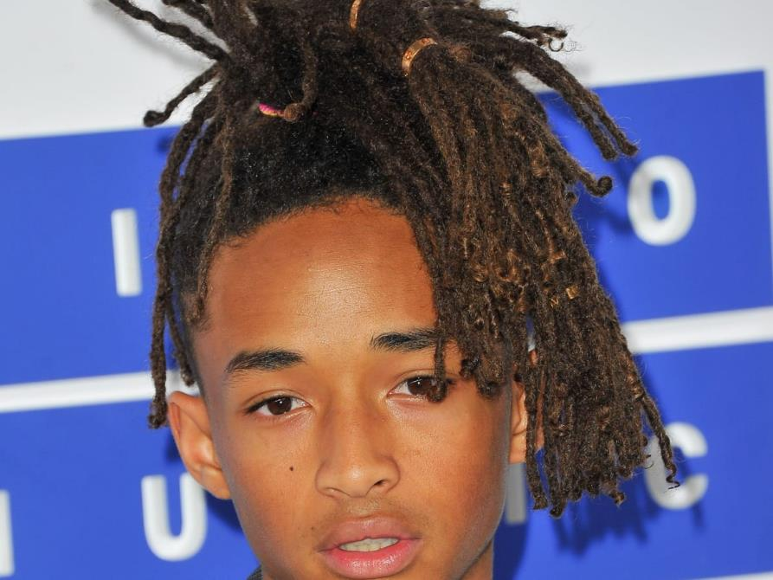
4.

Slide 9
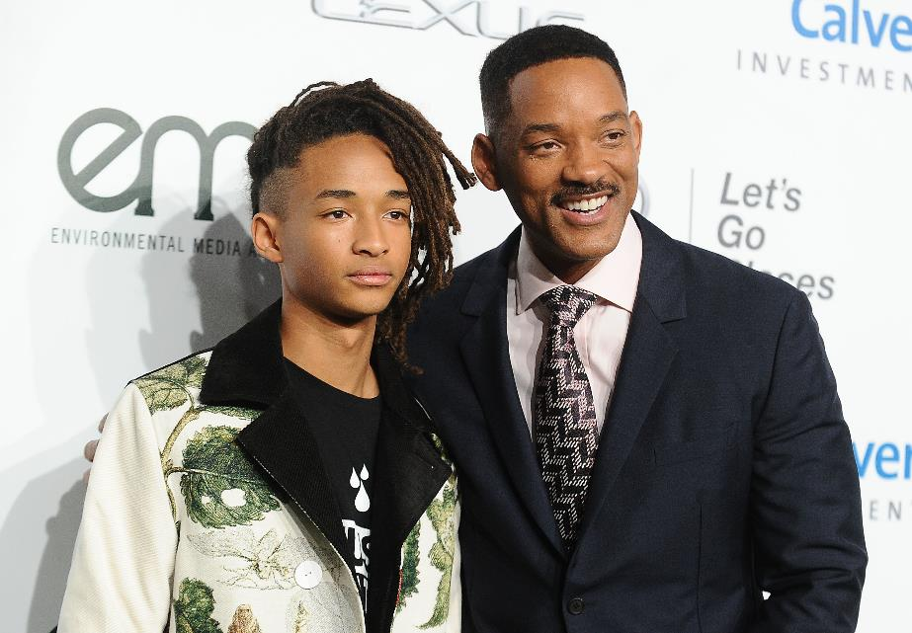
4.
Child: Jaden Smith
Father: Will Smith

Slide 10
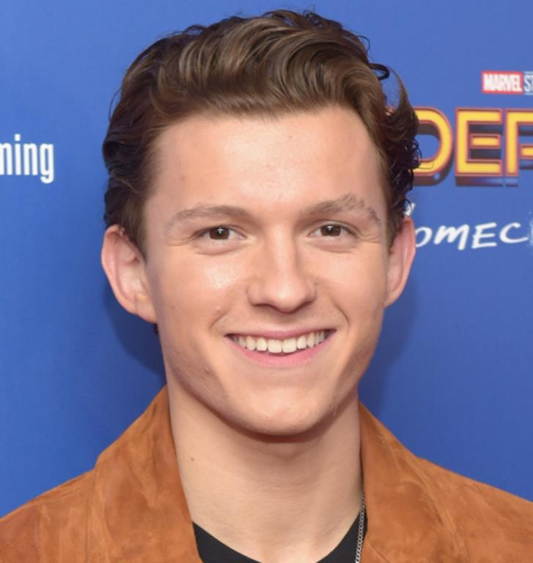
5.

Slide 11
5.
Child: Tom Holland
Father: Dominic Holland

Slide 12
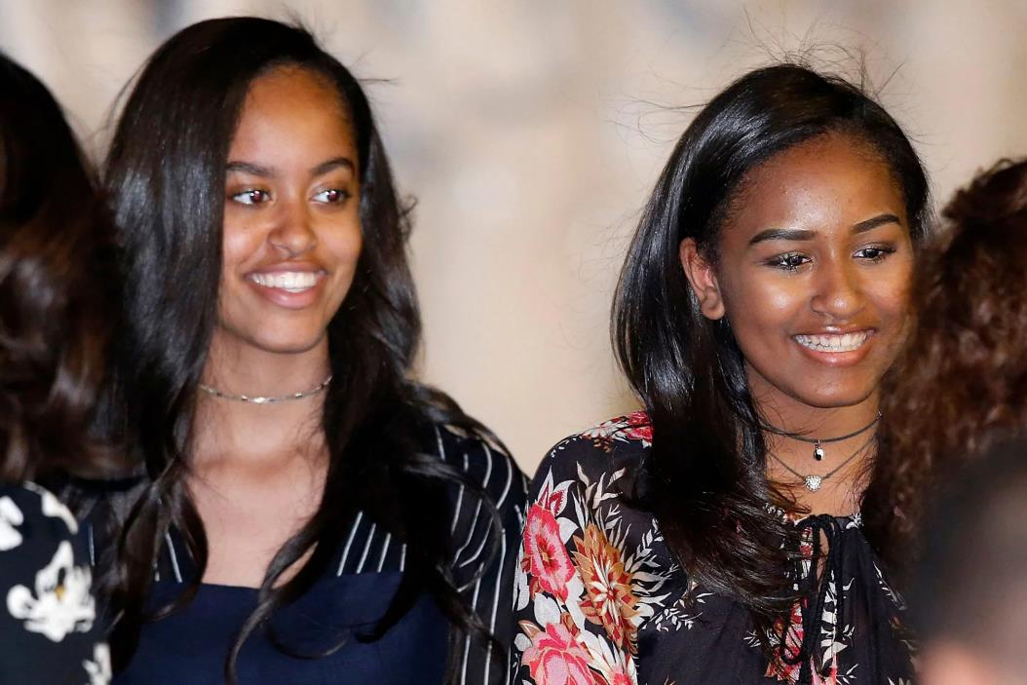
6.

Slide 13
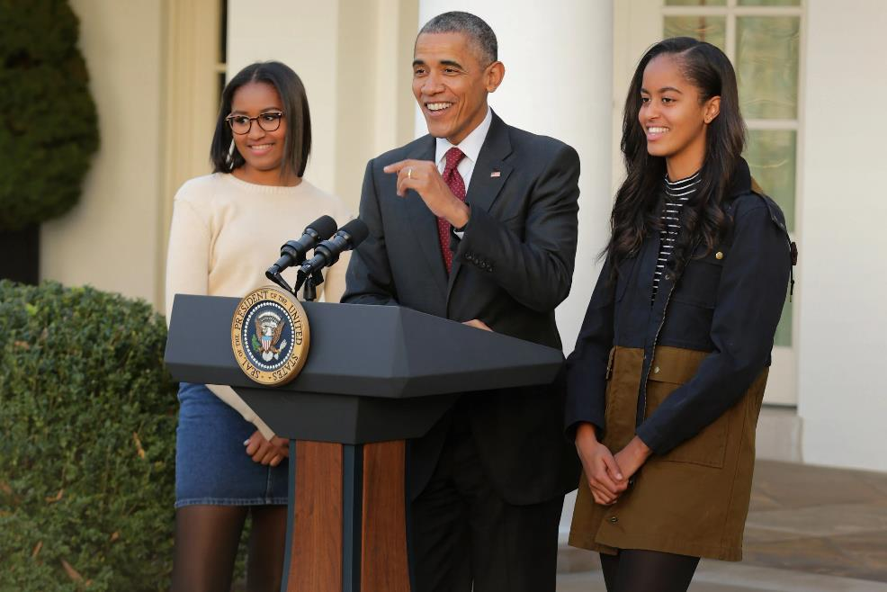
6.
Child: Malia & Sasha Obama
Father: Barack Obama

Slide 14
7.

Slide 15
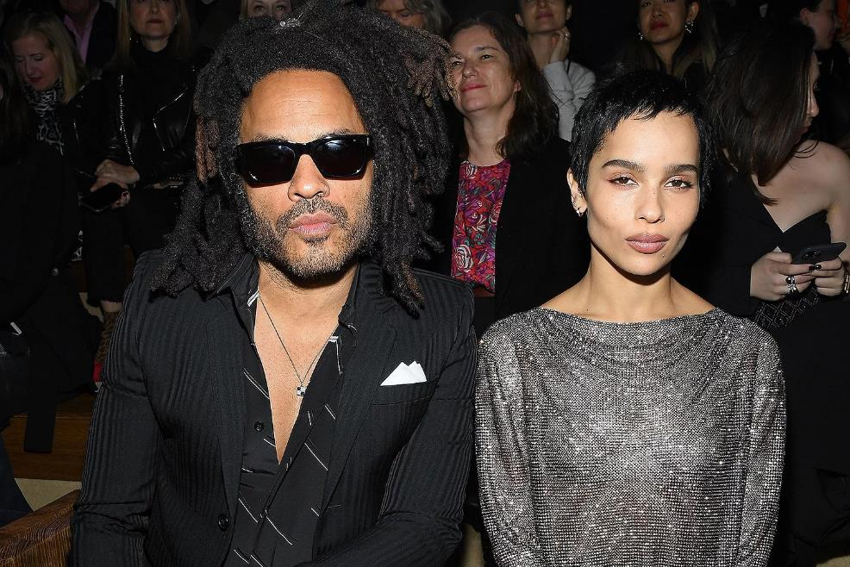
7.
Child: Zoe Kravitz
Father: Lenny Kravitz

Slide 16
8.

Slide 17
8.
Child: Tilly Ramsay
Father: Gordon Ramsay

Slide 18
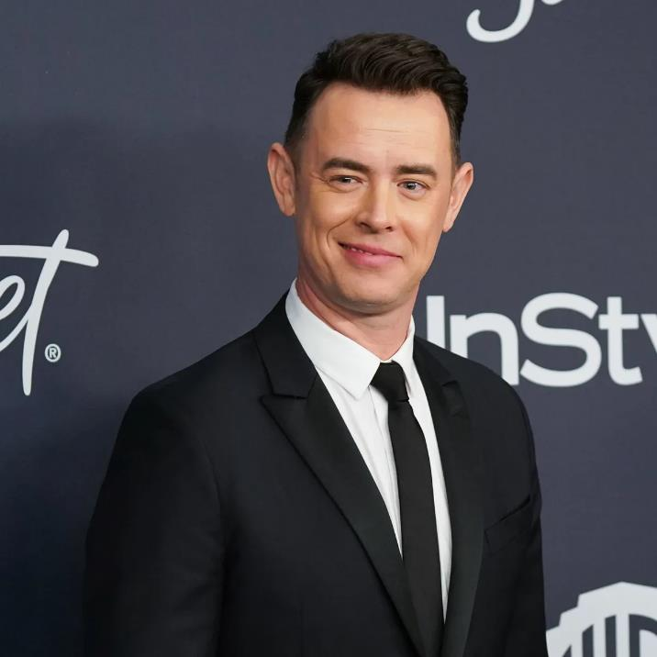
9.

Slide 19
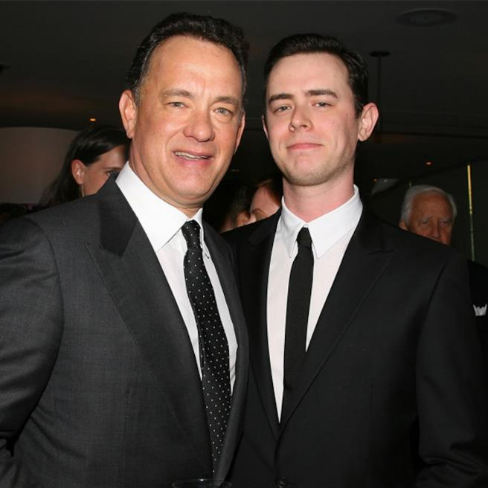
9.
Child: Colin Hanks
Father: Tom Hanks

Slide 20
10.

Slide 21
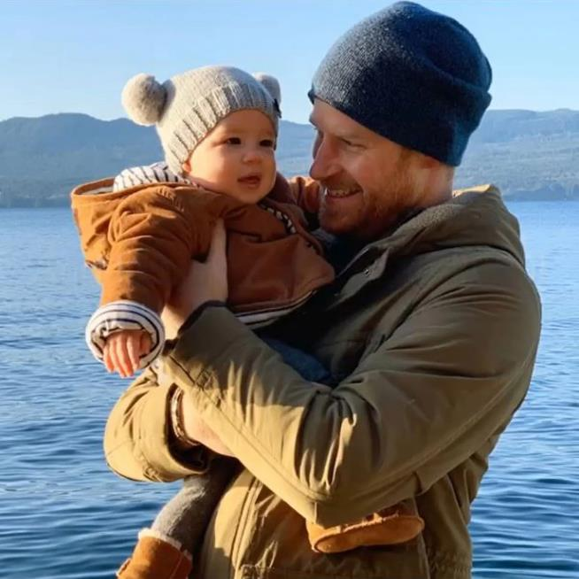
10.
Child: Archie Mountbatten-Windsor
Father: Prince Harry

